Slide 1
Copyright Indezine.com

Slide 2
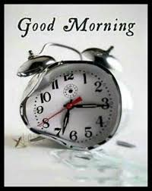
He is the guy who wakes you up
Even if you hit him
Even if you throw him
He does his work even though he knows you hate him

Slide 3
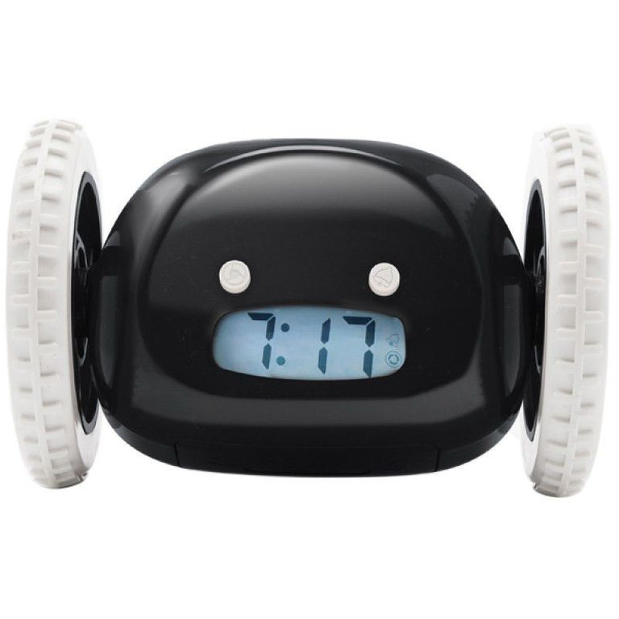
Running away alarm clock
Need a little extra incentive to pry yourself out of bed? You'll have plenty of it with this no-nonsense wheeled alarm clock

Slide 4
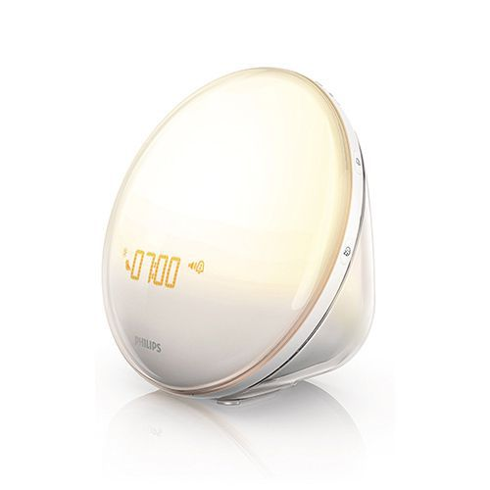
Sunrise simulation alarm clock
Now you can wake up to the sun without even opening your curtains.

Slide 5
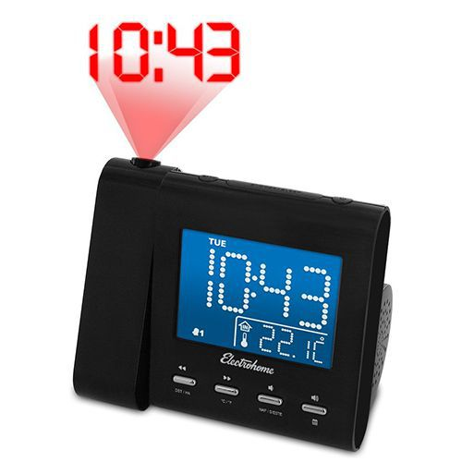
Projection alarm clock
Never squint to see what time it is again, especially when you're waking up 20 times in the middle of the night

Slide 6
Thank you
KRISHNA SRIHITH
A M PRAJWAL
SAI KRISHNA
SAURABH SINGHAL

